Slide 1
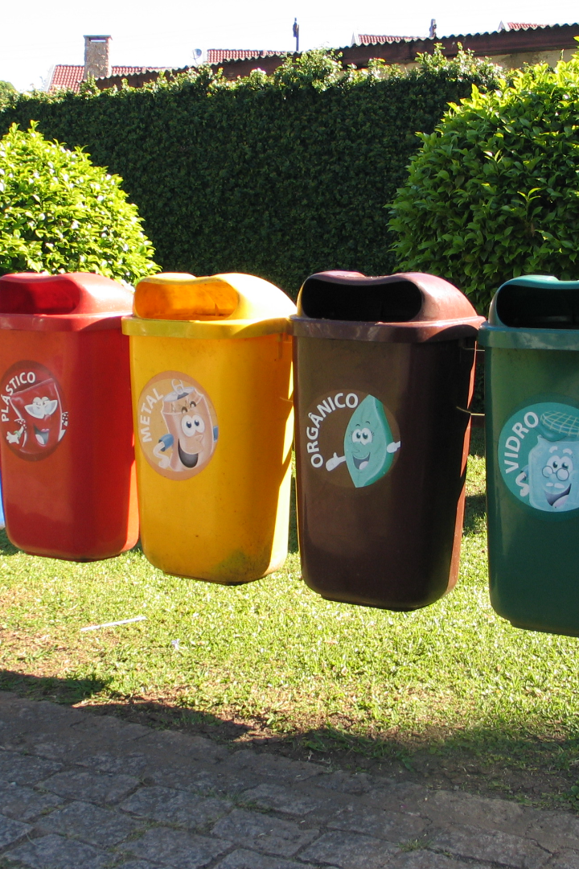
Complaint Registration Application for Urban/Rural Areas
The Complaint Registration Application for Urban/Rural Areas is a revolutionary solution to address complaints related to waste material, streetlight issues, sewer line blockages, road repairs, and more in both urban and rural regions.

Slide 2

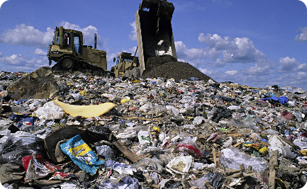
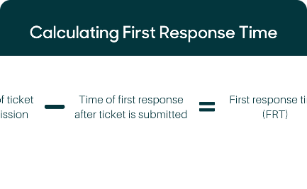
Application Features
Complaint Types
Benefits of the Application
Automation technologies such as Machine Learning
Data Science
Image Processing
Powered by Flutter for efficient and user-friendly app development.
Waste material management
Streetlight maintenance
Sewer line blockages.
Road Potholes
Improvement in complaint reporting and response time
Enhanced transparency
greater accountability Transforming urban and rural regions one complaint at a time.

Slide 3
Technologies we are using
Flutter Framework
Machine Learning
A powerful cross-platform development framework that ensures consistent performance and a seamless user experience across different devices.
Intelligent algorithms analyze complaint data and patterns, enabling faster and more accurate resolutions.
Data Science
Image Processing
Extracting insights from vast amounts of data to drive informed decision-making and optimize complaint management processes.
Analyzing images to identify visual evidence of complaints, enabling quicker identification and appropriate responses.
Computer Vision
Computer vision is a multidisciplinary field of artificial intelligence (AI) and computer science that focuses on enabling computers to interpret and understand visual information from the world, much like the human visual system.

Slide 4
Figma Prototypes
Explore our interactive Figma prototypes to visualize the Complaint Registration Application for Urban/Rural Areas. These prototypes provide a user-friendly interface and showcase the various features and functionalities of our application.
Click the links below to access the prototypes:
1
User/Citizen
2
Upper Divisional Office
Figma Link
Figma Link
3
Divisional officer
Figma Link

Slide 5
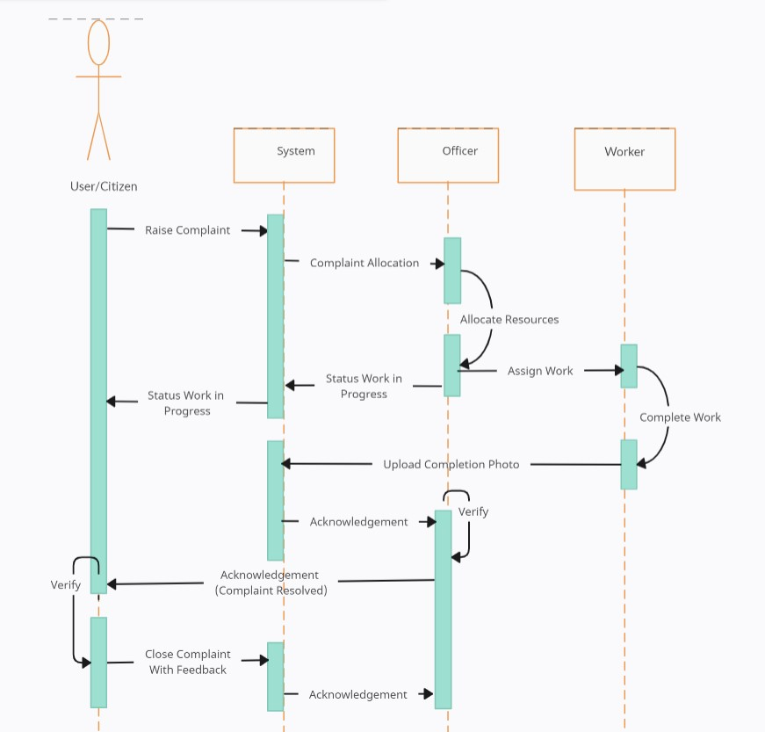
Sequence Diagram

Slide 6
Required Datasets
To successfully develop the Complaint Registration Application for Urban/Rural Areas, we need access to the following datasets:
1
Municipal corporation’s Geofencing dataset
2
Civil complaint Classes dataset
3
Local authorities hierarchy dataset
4
Historical civil complaints dataset

